Slide 1

Lead Scoring Case Study
By Kanika Khattar Ahuja
Divya Namani

Slide 2
Problem Statement
An education company named X Education sells online courses to industry professionals. On any given day, many professionals who are interested in the courses land on their website and browse for courses.
When these people fill up a form providing their email address or phone number, they are classified to be a lead. Moreover, the company also gets leads through past referrals. Once these leads are acquired, employees from the sales team start making calls, writing emails, etc. Through this process, some of the leads get converted while most do not.
The company requires you to build a model wherein you need to assign a lead score to each of the leads such that the customers with higher lead score have a higher conversion chance and the customers with lower lead score have a lower conversion chance.

Slide 3
Analysis Approach [1/2]
Step 1. Reading and Understanding the Data
Step 2.Data Cleaning and EDA
2.1 Missing value check
2.2 Cleaning and Visualizing categorical variables
2.3 Cleaning and Visualizing numerical variables
2.4 Outlier Treatment
2.5 Check for data type conversion
Step 3. Preprocessing and Data Preparation
3.1 Categorizing variables
3.2 Creating dummy variables
3.3 Train test split
3.4 Scaling data

Slide 4
Analysis Approach [2/2]
Step 4. Model Building
Step 4.1 Build Logistic Model
Step 4.2 Prediction and evaluation on Training Set
Step 4.3 Prediction and evaluation on Testing Set
Final Analysis

Slide 5
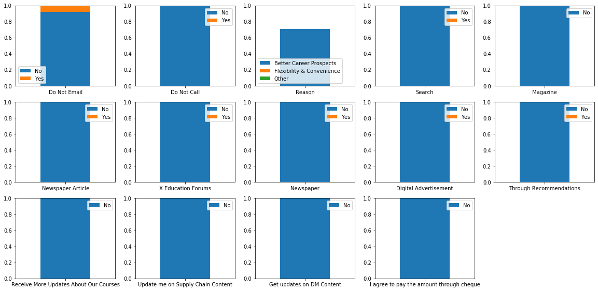
Cleaning and Visualizing Categorical Variables
Skewness in the categorical variables with more than 90% of value being same.
All these features were removed as they did not provide any insights.

Slide 6
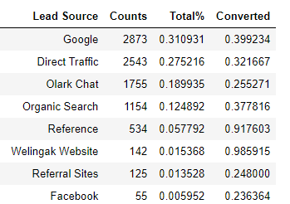
Cleaning and Visualizing Categorical Variables - Lead Source
Welingak Website has the maximum conversion rate followed by Reference
Google and Direct Traffic have top counts and a good conversion rate of close to 30%
We noticed that Lead Source is highly affected by Lead Origin. Therefore, replaced the missing values of Lead Source by the mode of Lead Source depending on the Lead Origin

Slide 7
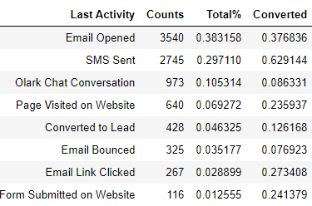
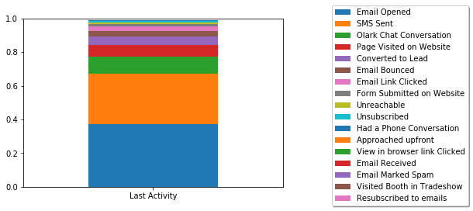
Cleaning and Visualizing Categorical Variables - Last Activity
SMS Sent has the maximum conversion rate followed by Email Opened. They both also has the top counts.
Olark Chat Conversion comprises of 10% of the leads and has the lowest conversion rate of 8%.
Replaced 103 missing values of Last Activity with its mode Email Opened

Slide 8
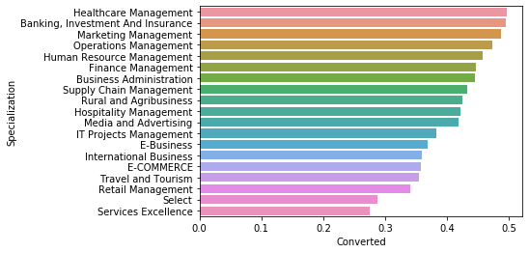
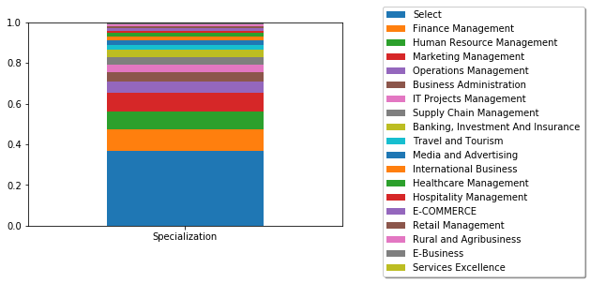
Cleaning and Visualizing Categorical Variables - Specialization
As the missing was large, replaced these value with others
Leads with Finance Management as Specialization are maximum and has a good conversion rate.

Slide 9
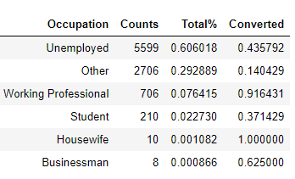
Cleaning and Visualizing Categorical Variables - Occupation
60% of leads are Unemployed and they have good conversion rate of 43%
Though number of working professional is less, but their conversion rate is higher at 91%
The missing percentage is 29%. Replacing with mode might have skewed the data.
Therefore, replaced null values in Occupation with value Other

Slide 10
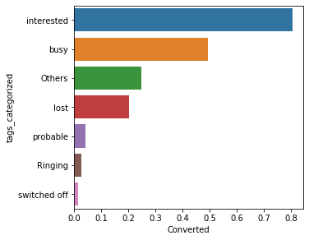
Cleaning and Visualizing Categorical Variables - Tags
There were 27 different values of Tags.
Bucketing them into following categories based upon the business knowledge
Interested
Busy
Probable
Lost
Interested and busy tags had the maximum conversion rate

Slide 11
Cleaning and Visualizing numerical Variables
There are three Numerical columns
1.TotalVisits.
2.Total Time Spent on Website(Website time)
3.Page Views Per Visit
Outlier Treatment:
Columns TotalVisits and Page Views Per Visit have been capped at 99% values because of the presence of outliers.

Slide 12
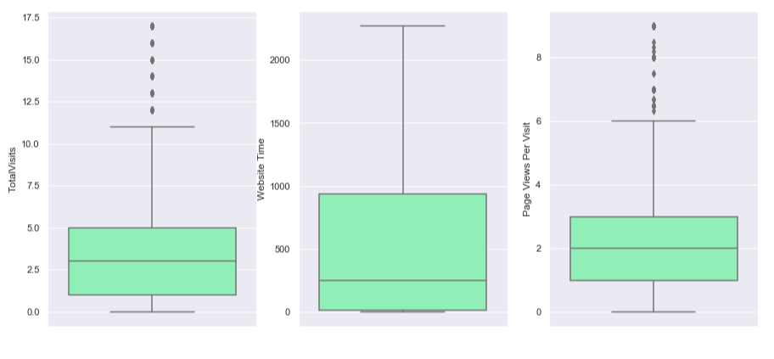
Cleaning and Visualizing numerical Variables
Data spread of the numerical columns after treating the outliers:

Slide 13
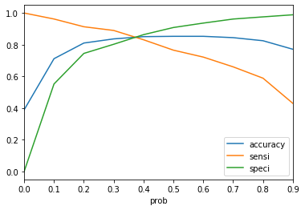
Model Building
RFE was used to reduce the variables
Model was finalized with 12 variables.
Optimal cutoff was decided based on trade off of accuracy,sensitivity and specificity.
The model predicted the probabilities which was further used to calculate the Lead Score
The value 3.5 seems to be a good cutoff as all the metrics values are intersecting.

Slide 14
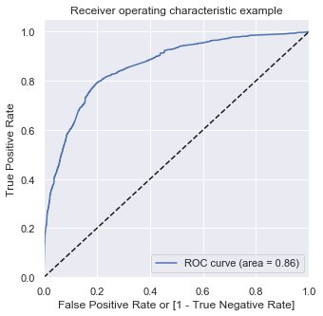
Evaluations on training data
Training Accuracy: 0.79
Training Sensitivity: 0.80
Training Specificity: 0.79
The F1 score of training is 80%
The ROC curve area is 86% which is good enough

Slide 15
Evaluations on testing data
Testing Accuracy = 0.79
Testing Sensitivity: 0.80
Testing Specificity: 0.79
F1 score of test data is 80%

Slide 16
Final Analysis - Features
Features Coeff
Occupation_Working Professional 2.9662
Lead Source_Reference 2.8502
Last Activity_SMS Sent 1.6785
Website Time 0.9859
Last Activity_Email Opened 0.6105
Lead Source_Olark Chat 0.2311
TotalVisits 0.0683
Lead Source_Direct Traffic -0.2514
Country_India -0.2983
Lead Origin_Landing Page Submission -0.5406
Last Activity_Converted to Lead -0.8215
Last Activity_Olark Chat Conversation -0.9478

Slide 17
Final Analysis - Conclusion and Recommendations
As sensitivity is 80%, therefore, all the leads with lead score > 35 (a potential lead) have 80% chance of getting converted.
Top 3 dummies that contributes most towards increasing the probability are:
Occupation_Working Professional (currently 92% conversion rate)
Lead Source_Reference (currently 91% conversion rate)
Last Activity_SMS Sent (currently 63% conversion rate)
Of all the leads who are predicted as Converted, the sales team should follow the below strategy to increase the conversion rate:
If all the leads who are a working professional are targeted, 92% of them has a chance of getting converted. These leads should be targeted first.
Leads who come by reference have a chance of 91% conversion. Therefore, sales team should next target these leads.

Slide 18
Final Analysis - Conclusion and Recommendations
Top variables that need to be worked on by the team are
Last Activity_Olark Chat Conversation(currently 8% conversion rate)
Last Activity_Converted to Lead(currently 12% conversion rate)
Lead Origin_Landing Page Submission (currently 36% conversion rate)
If company gets are chance to work on some new things, teams should working on the following:
Olark Chat Conversion comprises only 10% of the leads and out of which only 8% are converted. Chat Conversation is a good tool to know more about candidates and market the products. Therefore, team should work more on getting candidates from Olark chat and should improve the marketing skills on this platform.
Converted to lead in Last Activity comprises only 4% of the leads and out of which only 12% are converted. Converted to lead seems to be the first step when a particular person is treated as a lead. Teams should work on reaching to these customers at the earliest through other mediums like email, SMS or chat.

